Slide 1
CIS CONTROL 15: WIRELESS ACCESS CONTROL-III
WIRELESS ACCESS CONTROL

Slide 2
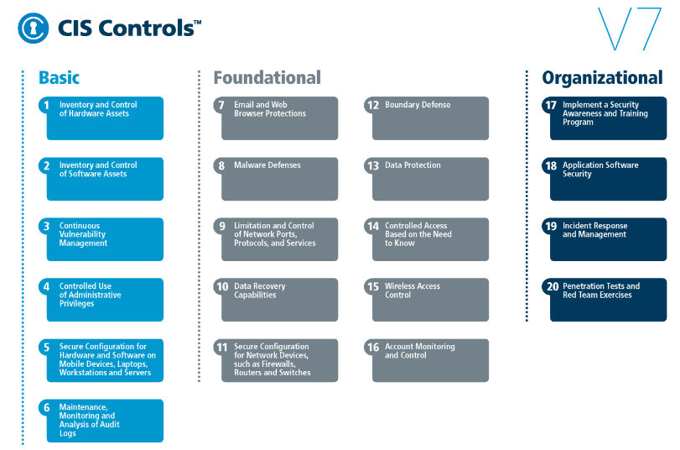
CIS CONTROL 15: WIRELESS ACCESS CONTROL-III
https://www.cisecurity.org/controls/

Slide 3
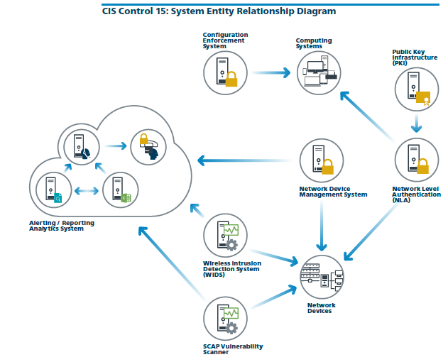
CIS CONTROL 15: WIRELESS ACCESS CONTROL-III
https://www.cisecurity.org/controls/

Slide 4
CIS CONTROL 15: WIRELESS ACCESS CONTROL-III
15.7: Leverage the Advanced Encryption Standard (AES) to Encrypt Wireless Data
Leverage the Advanced Encryption Standard (AES) to encrypt wireless data in transit.

Slide 5
CIS CONTROL 15: WIRELESS ACCESS CONTROL-III
15.8: Use Wireless Authentication Protocols that Require Mutual, Multi-Factor Authentication
Ensure that wireless networks use authentication protocols such as Extensible Authentication Protocol-Transport Layer Security (EAP/TLS), …

Slide 6
CIS CONTROL 15: WIRELESS ACCESS CONTROL-III
15.8: Use Wireless Authentication Protocols that Require Mutual, Multi-Factor Authentication
…that requires mutual, multi-factor authentication.

